Slide 1
SAN PEDRO CREEK ARTS
Program Update

Slide 2
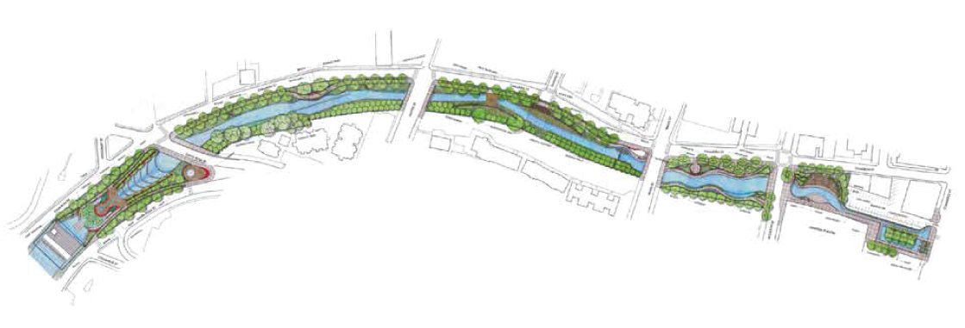
Permanent Artwork Overview
East Bank between Travis Street and Houston Street
West Bank between Travis Street and Houston Street
Bridges: Santa Rosa, Martin, Travis
Tunnel Inlet
Plaza de Fundacion
Tile Patterns and Word Art: multiple locations
West Bank between Santa Rosa Street and Martin Street
West Bank between Martin Street and Travis Street

Slide 3
Temporary Artwork Overview
Deck Overlook
Travis St Underpass
Martin Street Crosswalk

Slide 4
JORGE RODRIGUEZ-GERADA
Plaza de Fundacion

Slide 5
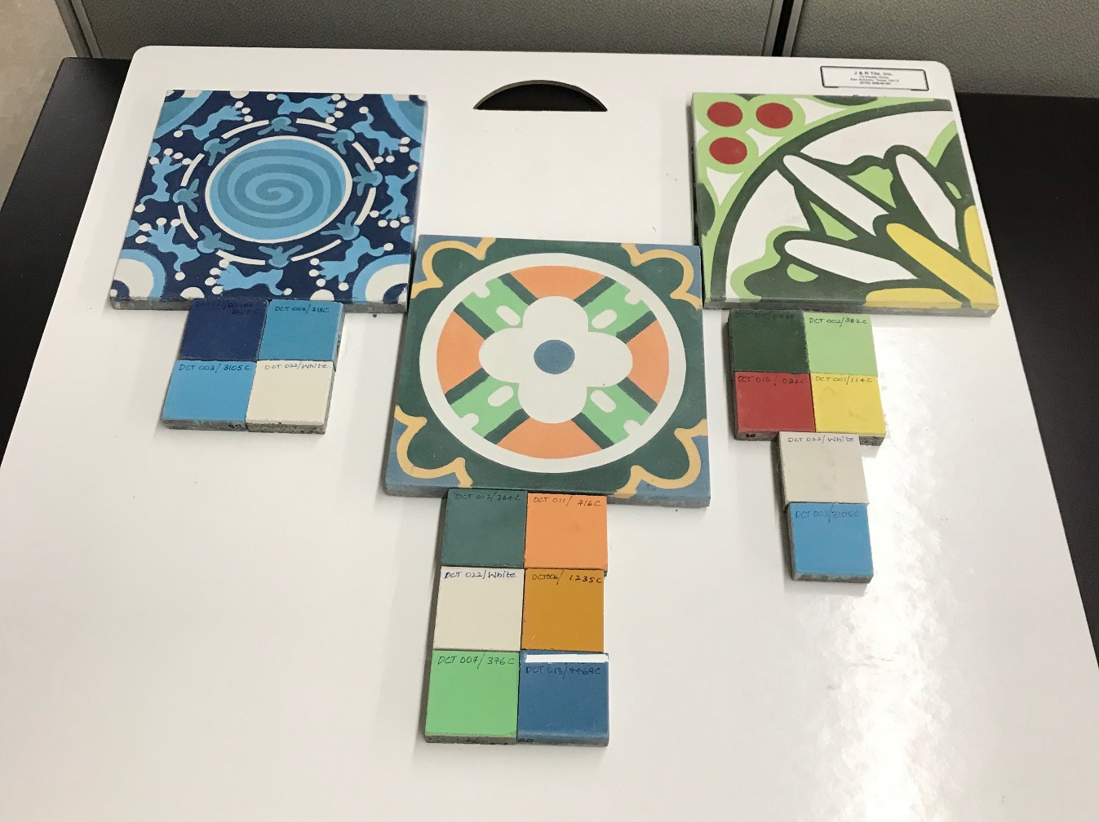
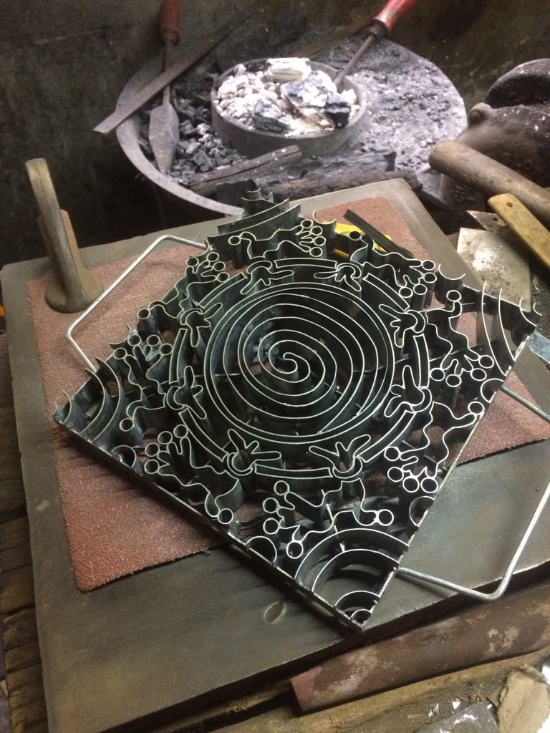
MICHAEL MENCHACA

Slide 6
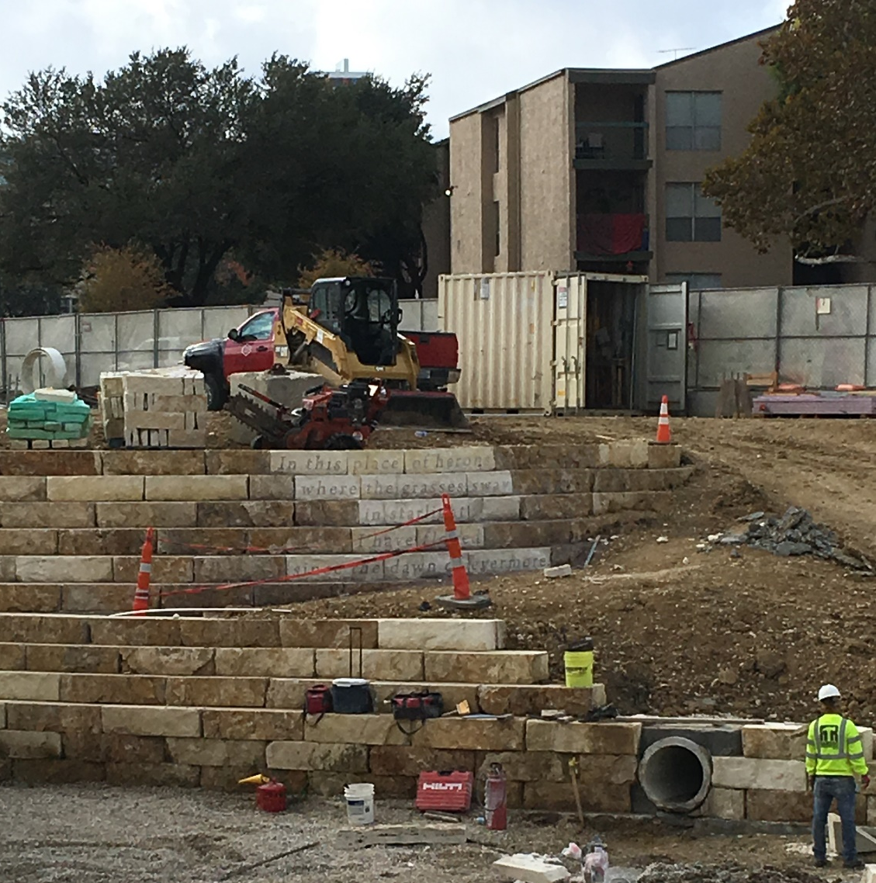
JOHN PHILLIP SANTOS
“In this place of herons
Where the grasses sway
In starlight I have flowed
Since the dawn of evermore”

Slide 7
DIANA KERSEY
Bridges: Santa Rosa, Martin, Travis

Slide 8
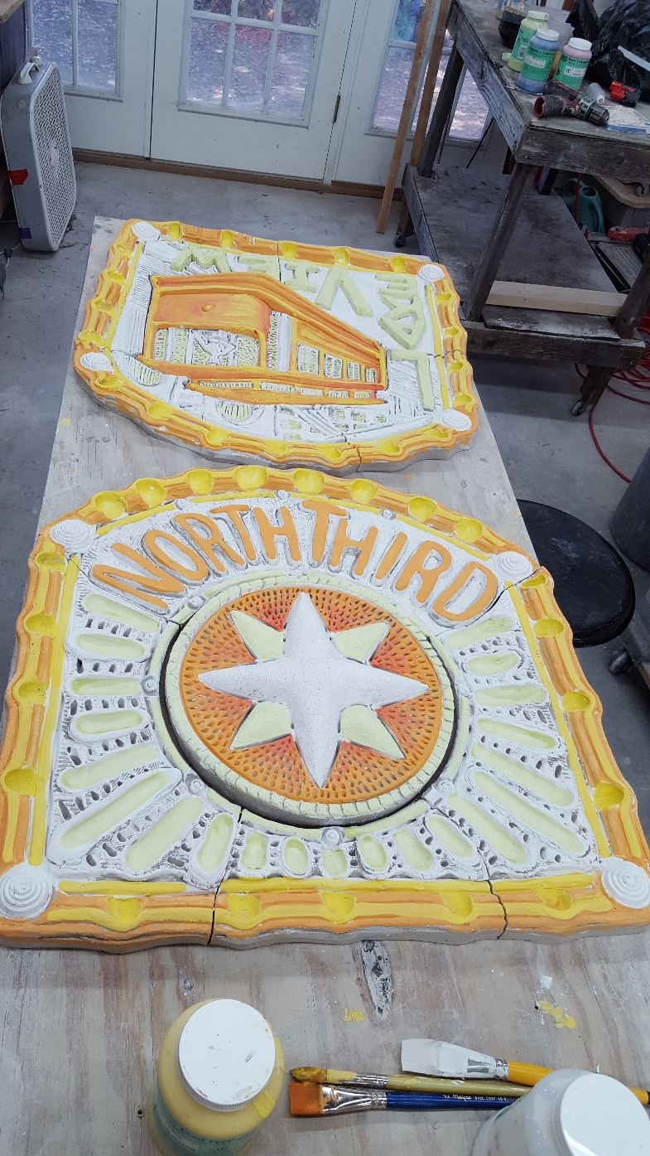
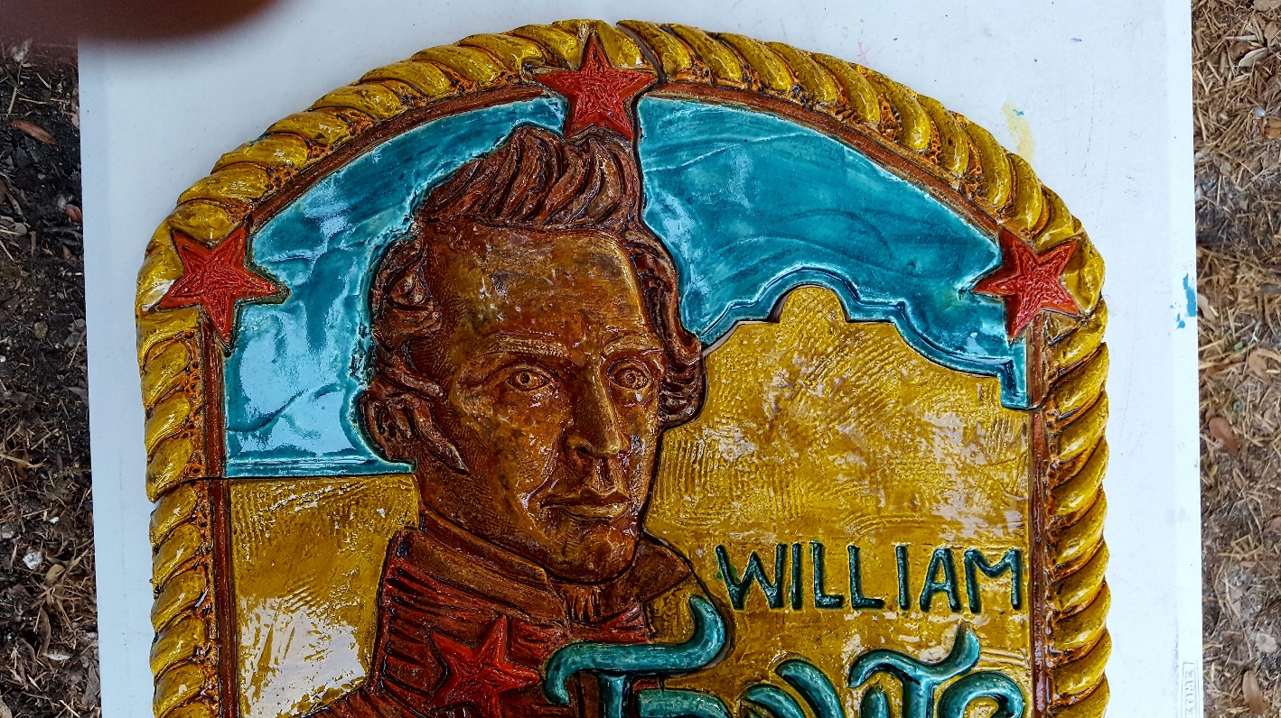
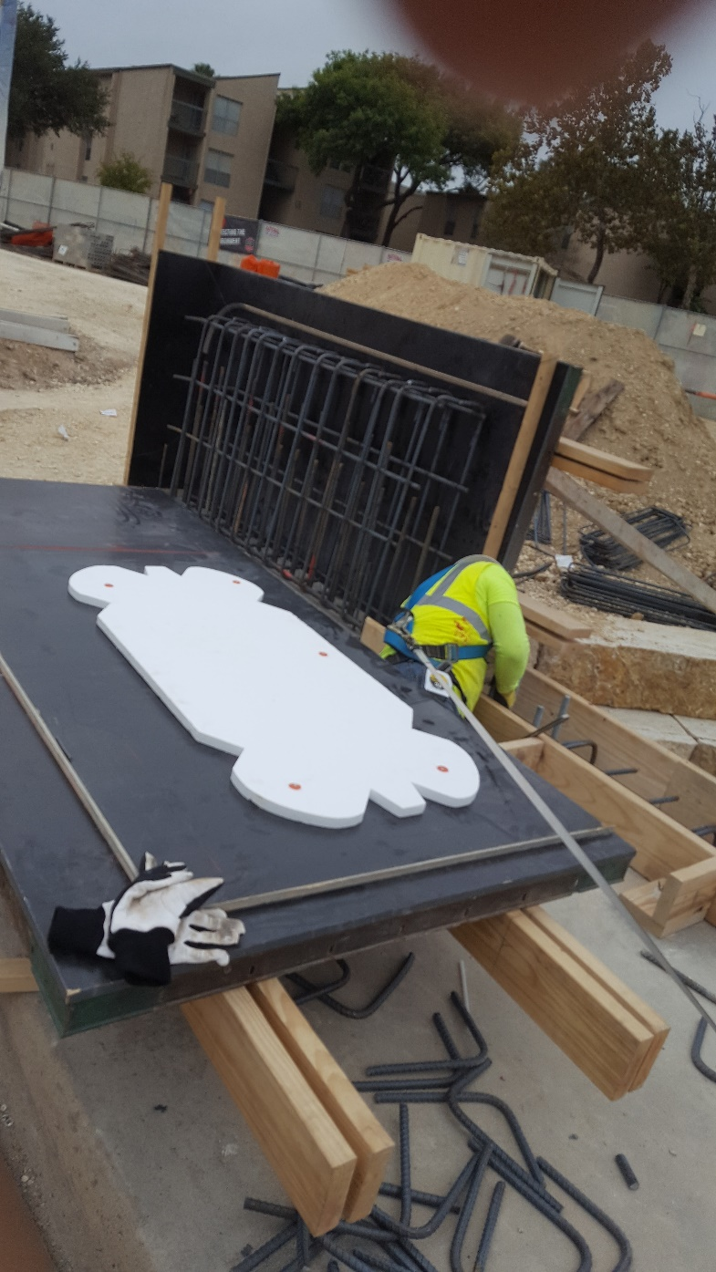
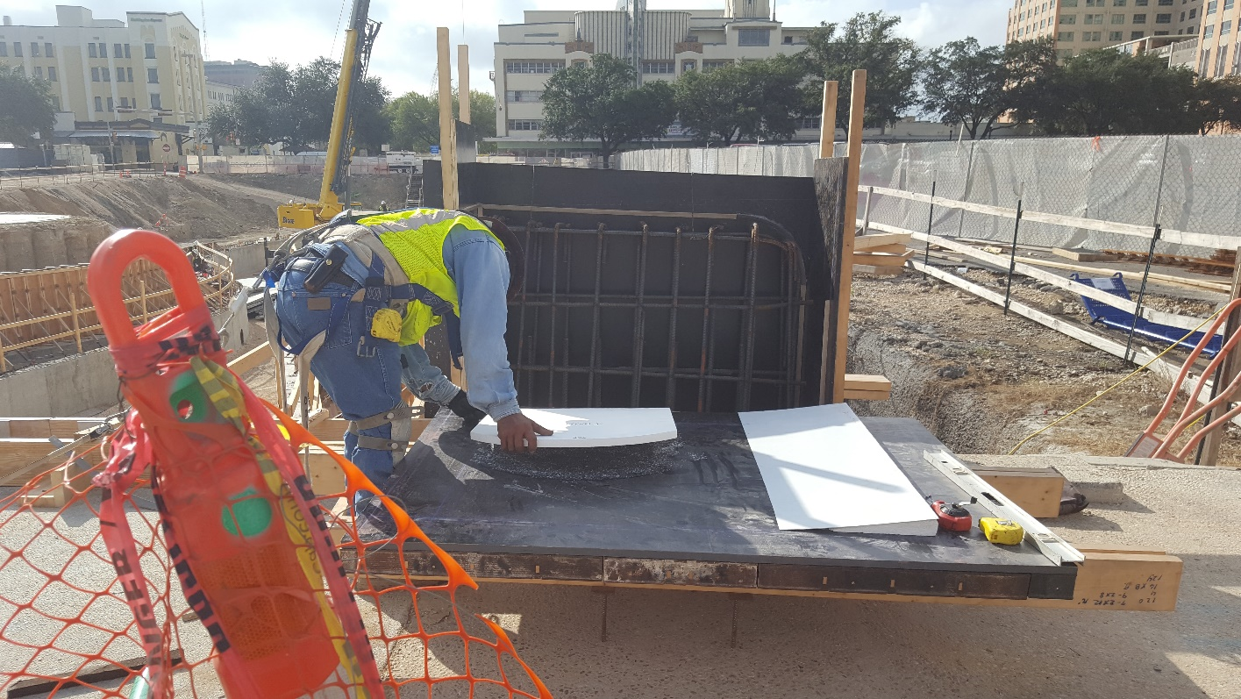
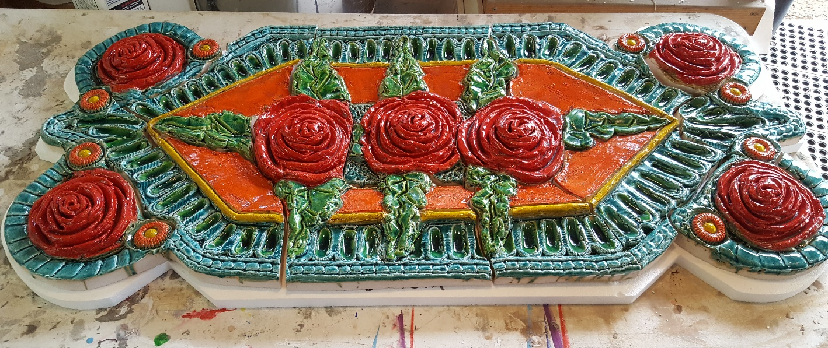

Slide 9
SAN PEDRO CREEK ARTS
Next steps
Oversee fabrication and installation of artwork
Frame and hang murals
Develop calendar of events for Segment 1
(May – December 2018)
Finalize artwork opportunities for Segment 2
Schedule next Arts & Culture Alliance meeting
Website update
Notes:
Website will include mural images

