Slide 1
Est. May 5th 2018

Slide 2
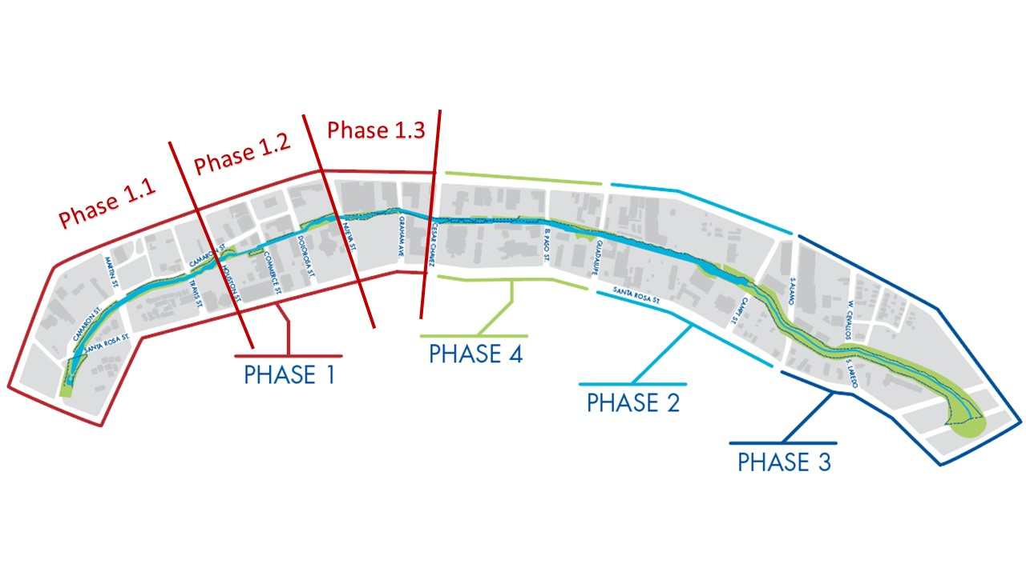
PROJECT PHASING

Slide 4
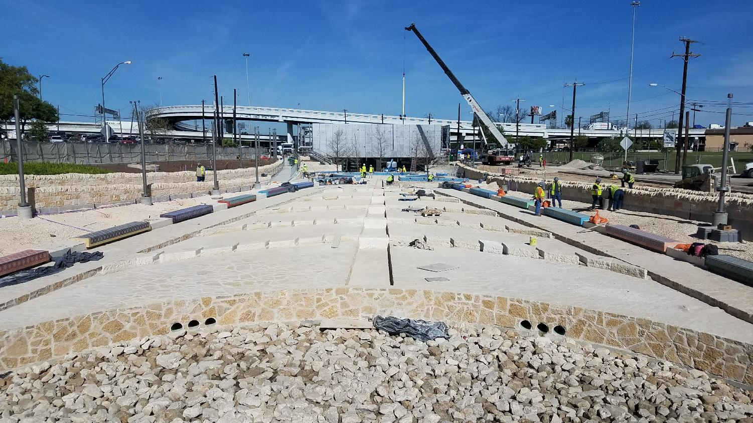

Slide 5
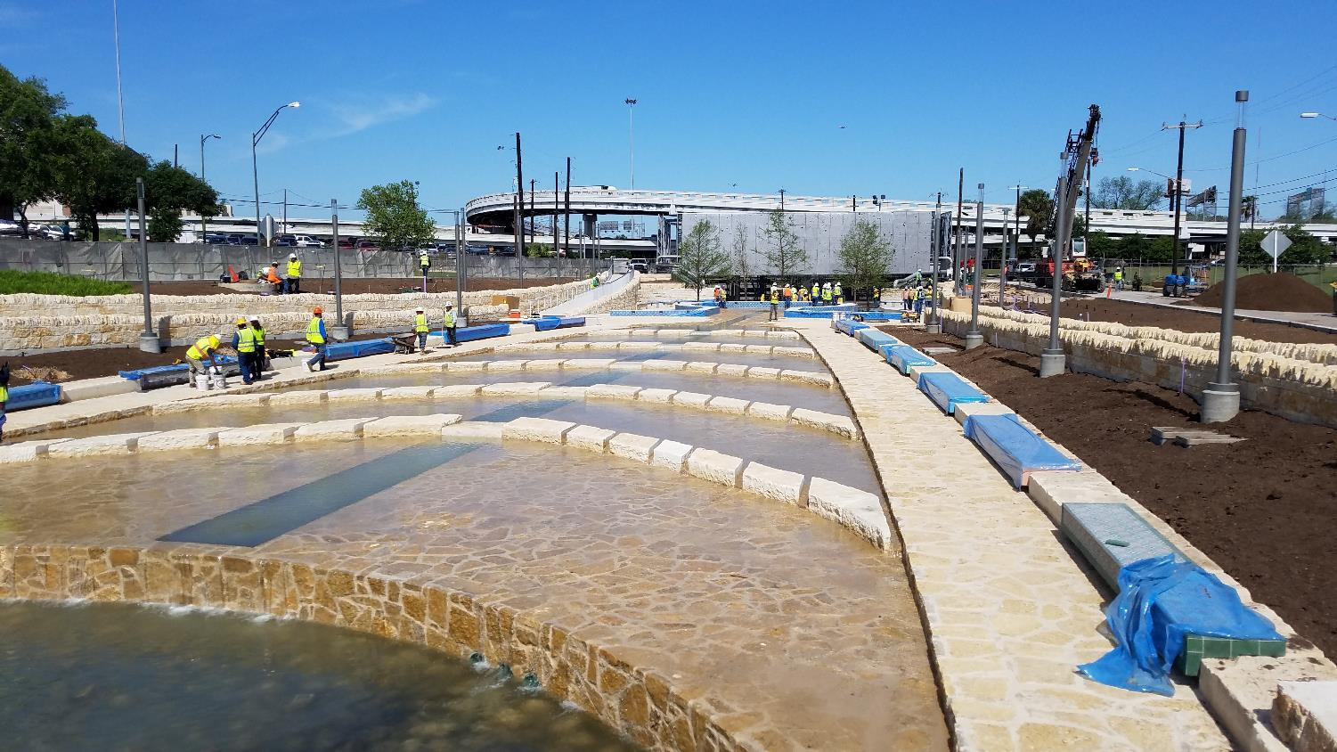

Slide 6
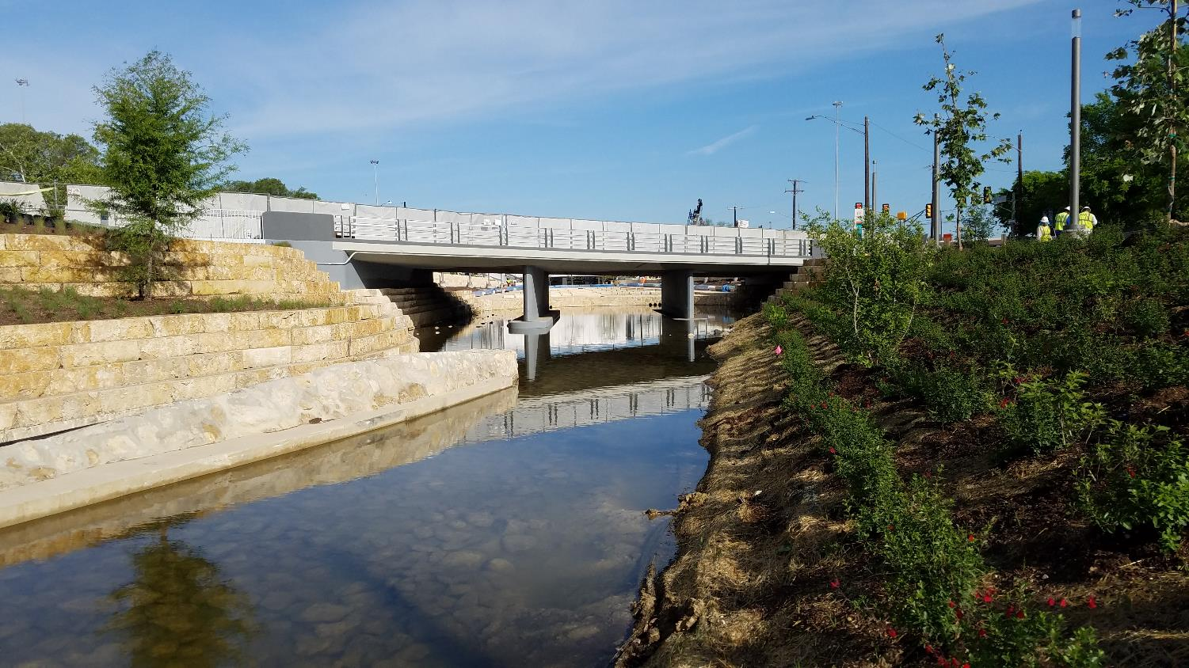

Slide 7
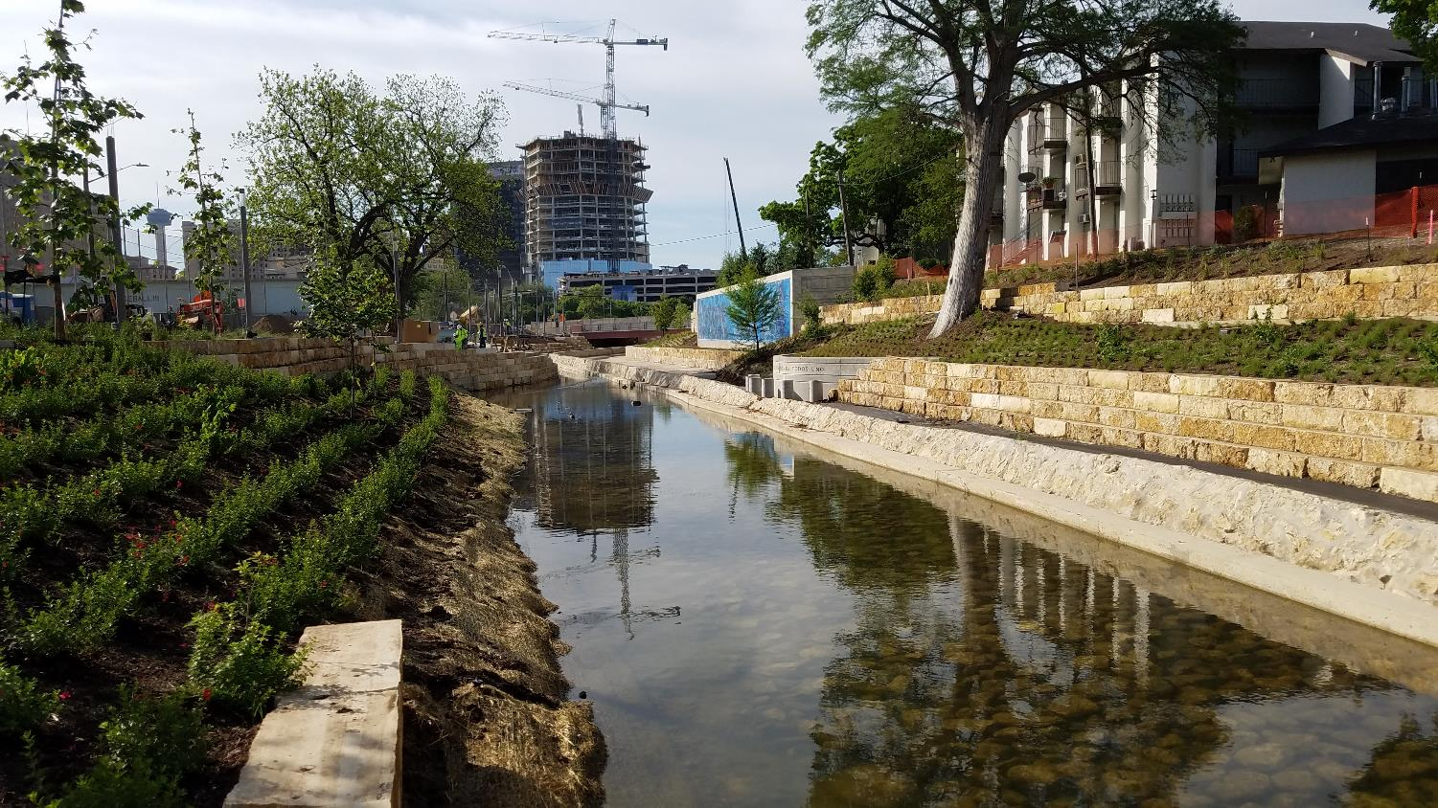

Slide 8
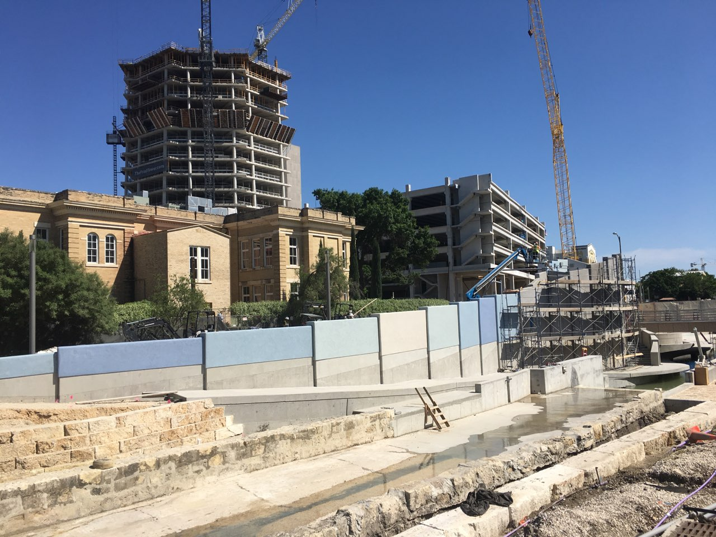

Slide 9
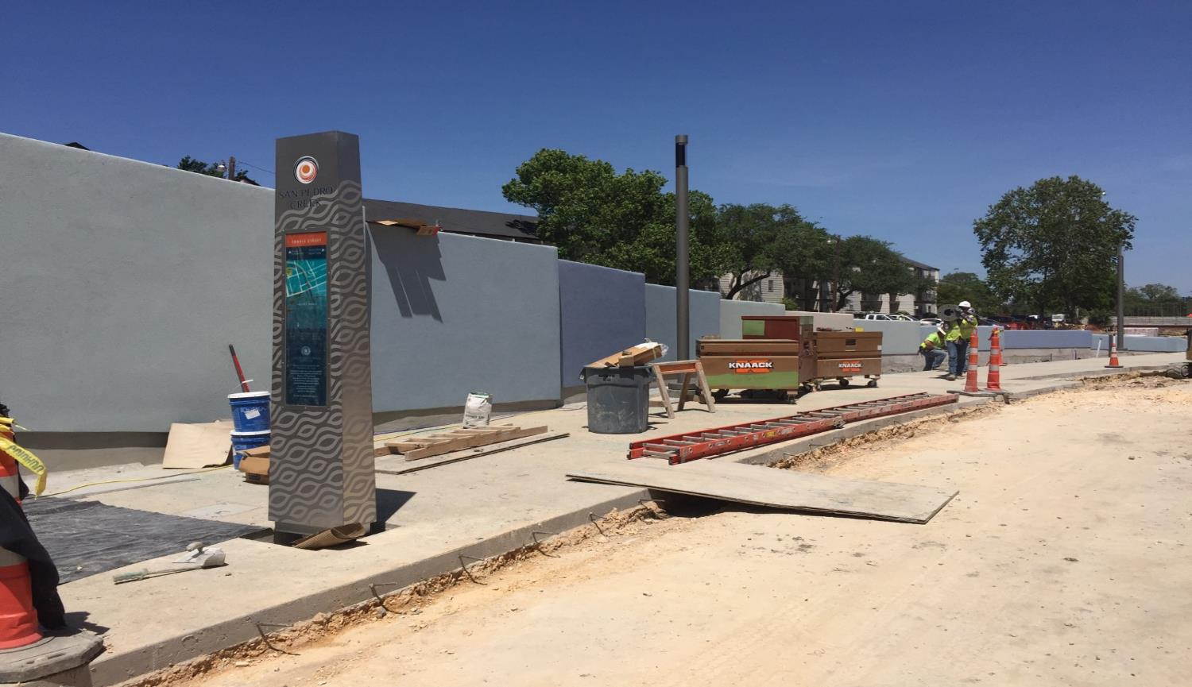

Slide 10
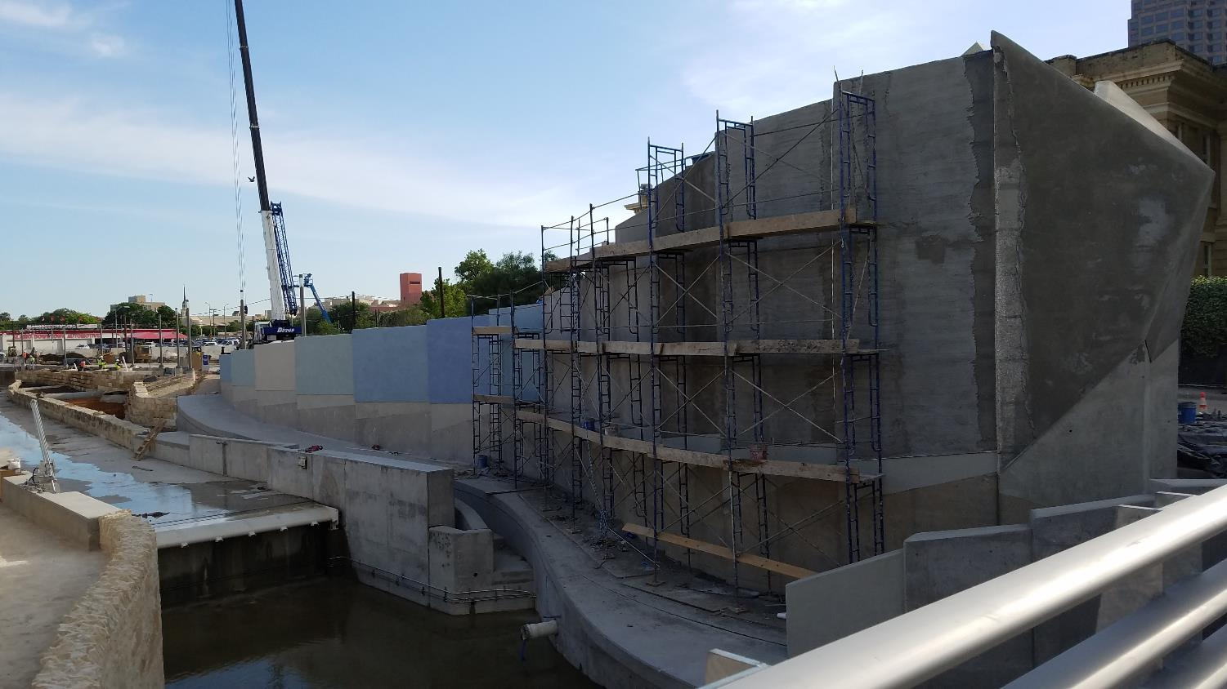

Slide 11
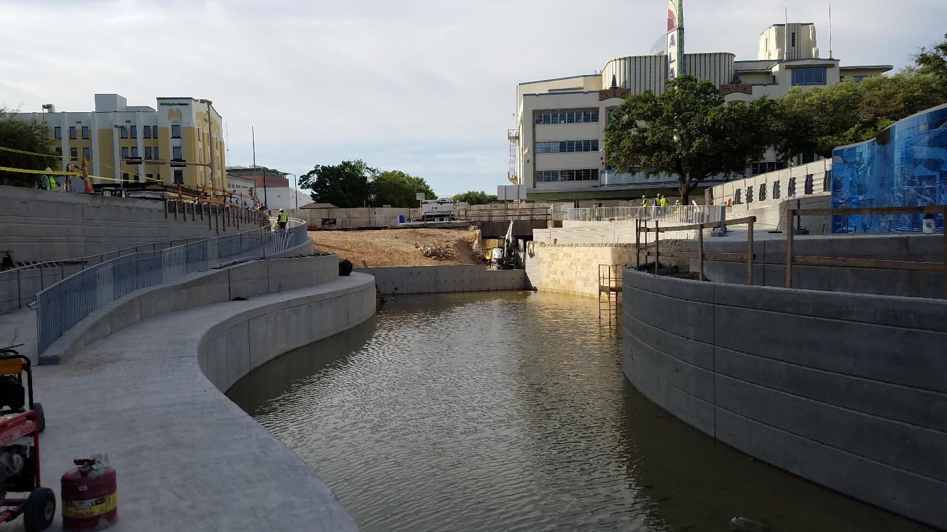

Slide 12
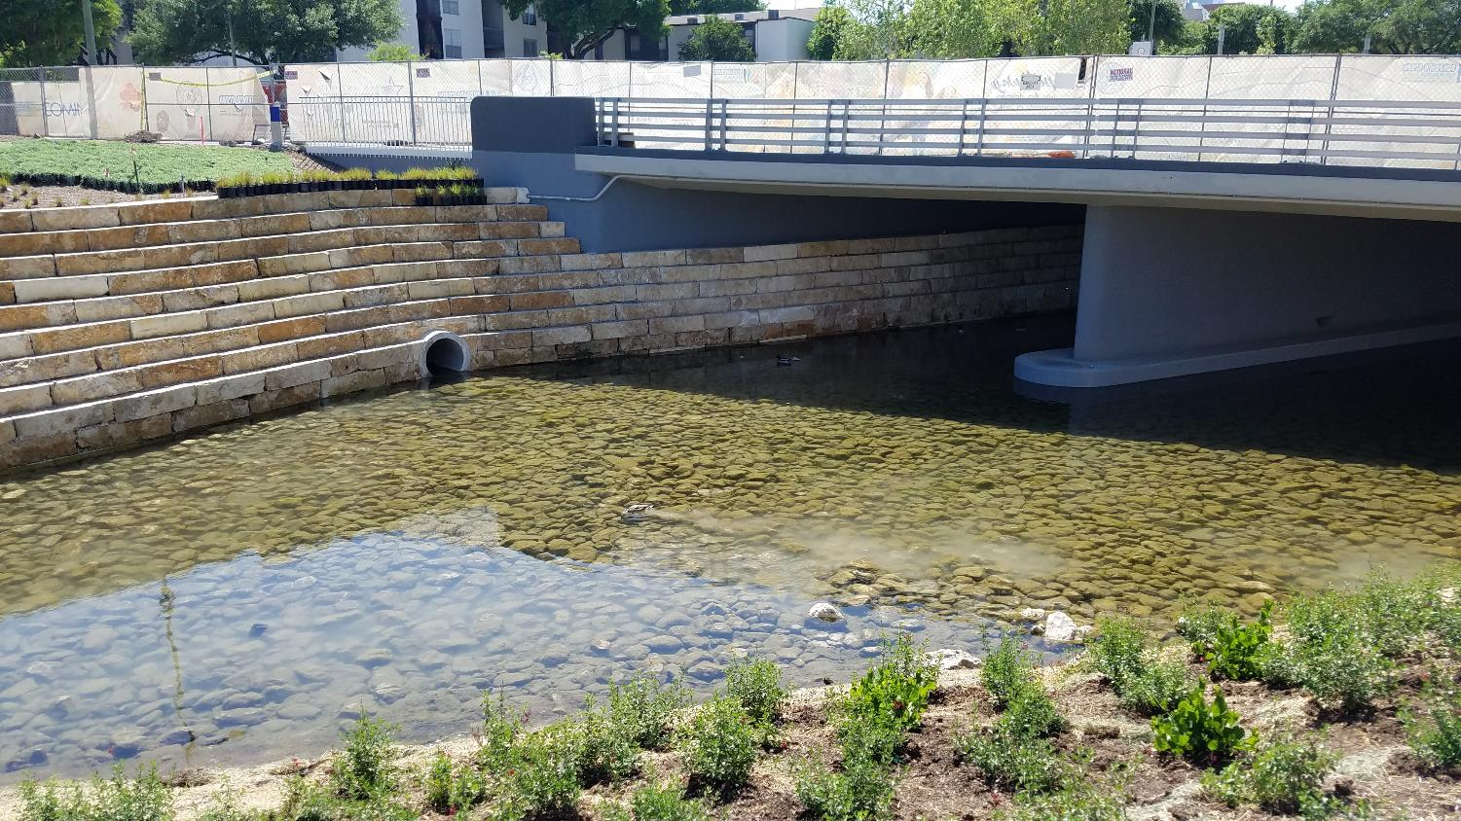

Slide 13
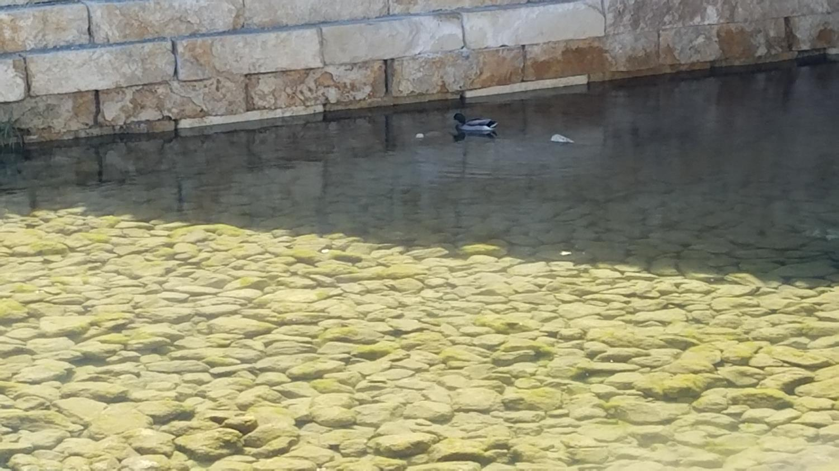

Slide 14
PHASE 1.2 DESIGN
90% design submitted March 31
Some design changes in Houston to Commerce block
100% design to be completed May 31
Design Charrette April 11

Slide 15
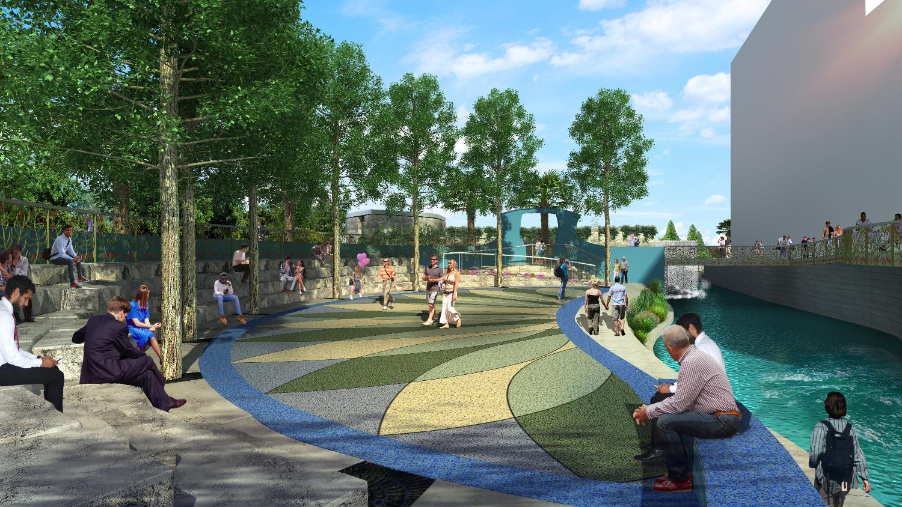

Slide 16
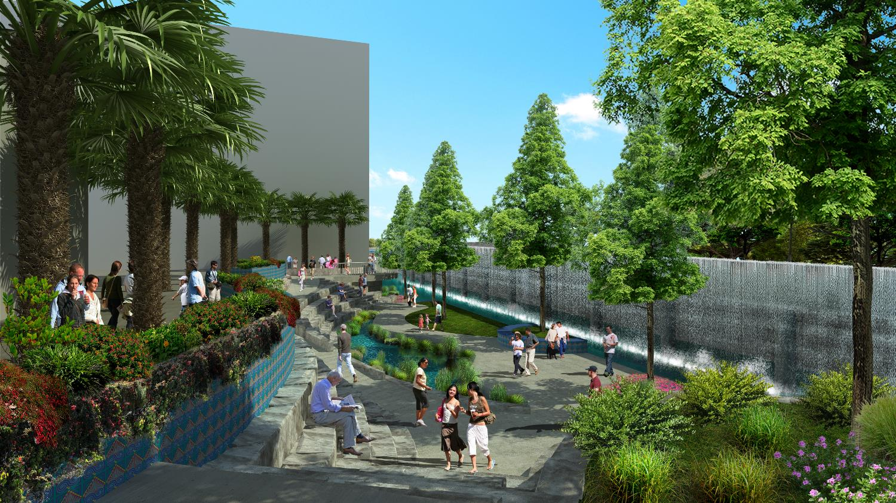

Slide 17
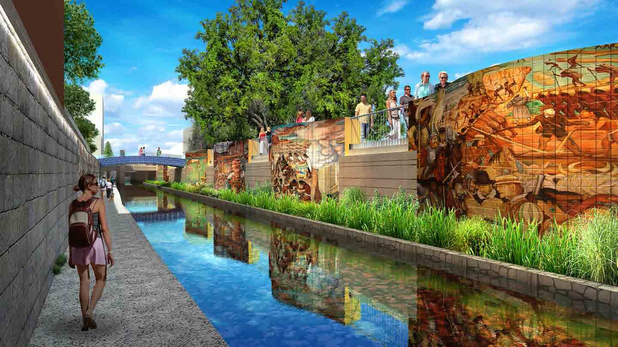

Slide 19
PHASE 1.2 CONSTRUCTION
Early Work Package 11
Demolition of former Dollar General building complete
Utility work on hold until after Fiesta
Calder Alley exploratory trenches complete
Early Work Package 12
Demolition of Alameda walkway complete
Drilled pier construction to start late April

Slide 20
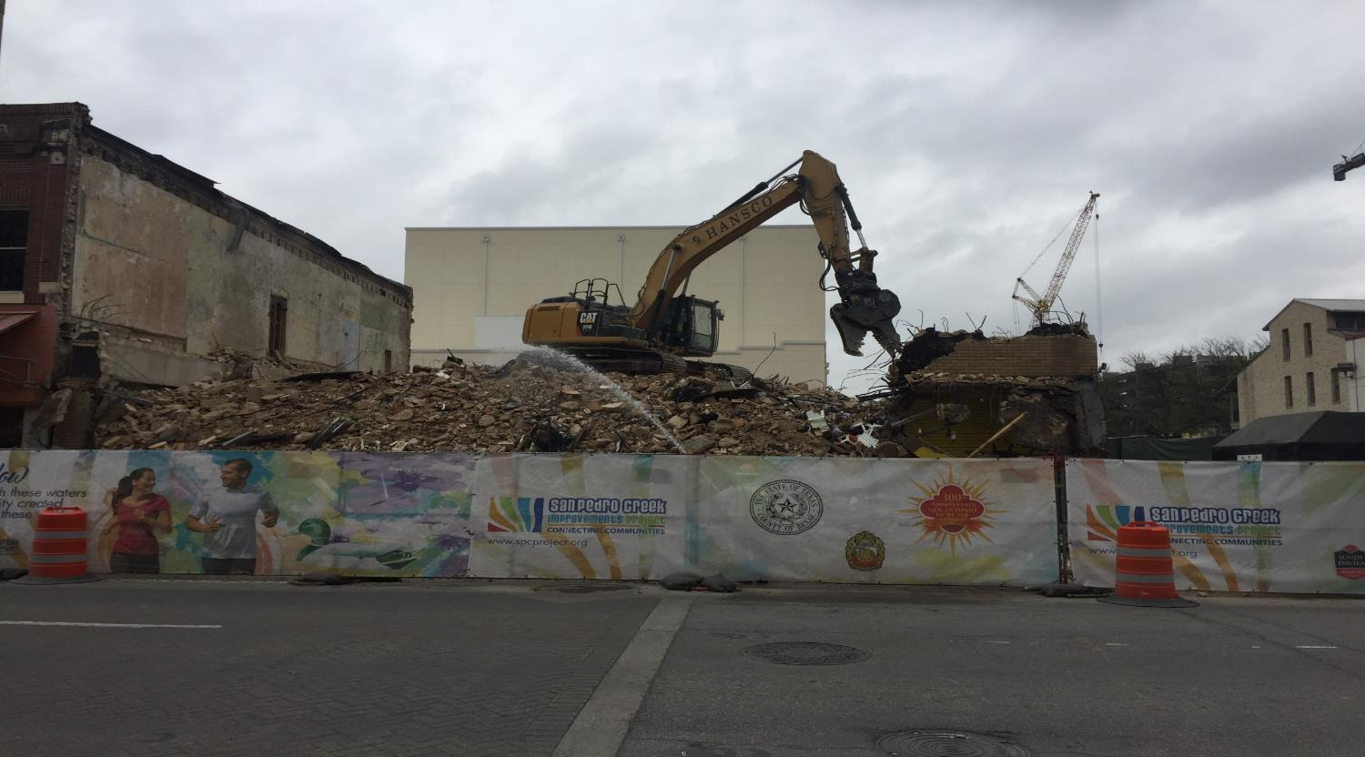

Slide 21
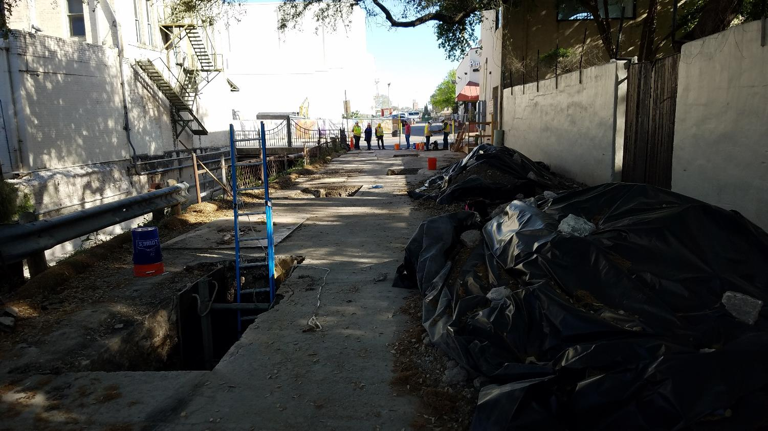

Slide 22
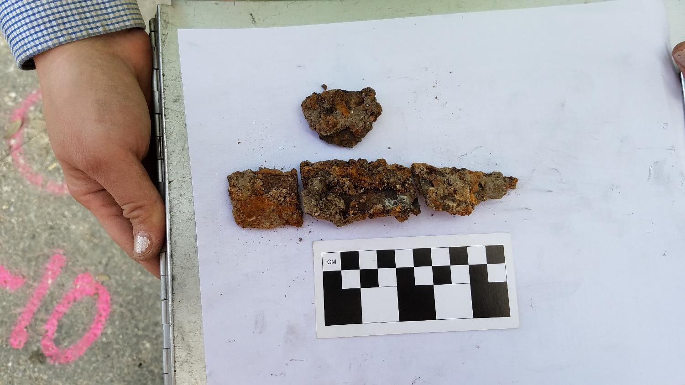

Slide 23
Phase 1.2 Timeline
100% submittal May 31
90% submittal Feb 28
Guaranteed Maximum Price July 31
Begin Full Construction Late Summer
Begin EWP Construction in February
Construction Completion Mid-2020

Slide 24
QUESTIONS

