Slide 2
San Pedro Creek Status Update
Phases 1.1 and 1.2 Construction
Phase 1.2 Design

Slide 3
PROJECT PHASING

Slide 4
DESIGN ENHANCEMENTS
CONSTRUCTION UPDATE

Slide 5
Phase 1.1 Construction Update
Sundt-Davila JV on schedule to complete construction of Phase 1.1 by May 5, 2018
Travis Gatehouse and wall complete
Impoundment gate received
Arsenal Pump Station construction ongoing
New drone video shot February 26

Slide 6
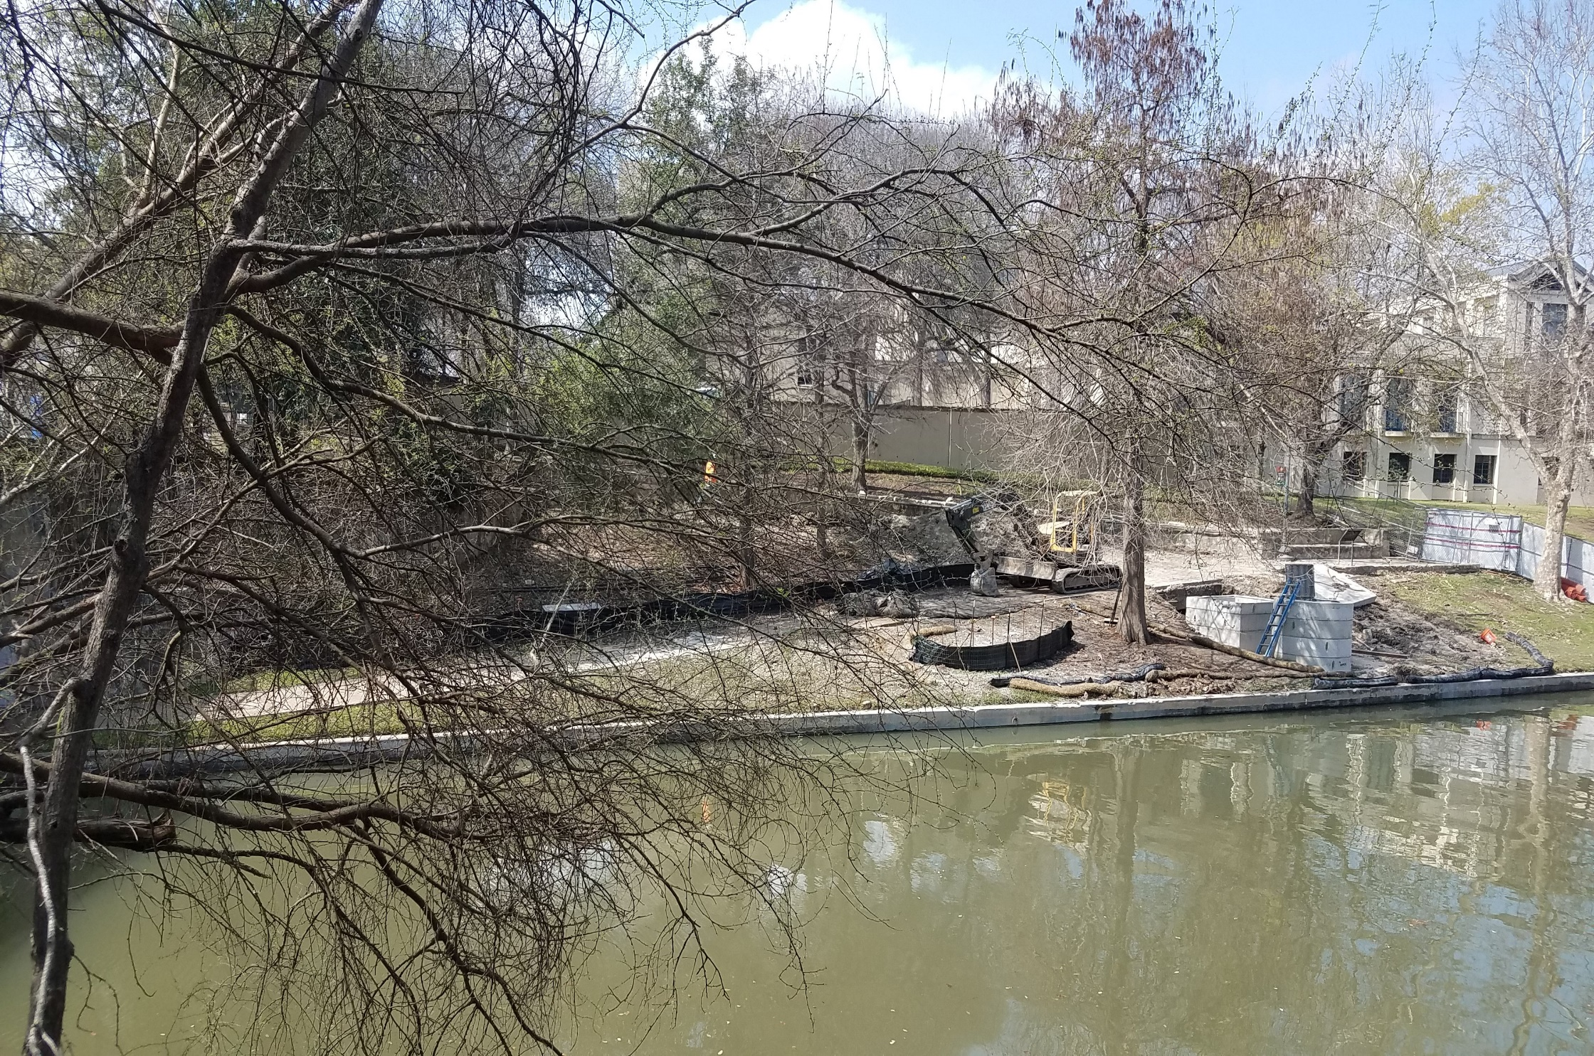

Slide 7
Phase 1.2 Construction Update
Early Work Package 11
Former Dollar General building no longer stands
Utility relocations ongoing
Early Work Package 12
Demolition and heavy civil work delayed due to cultural artifacts encountered in Calder Alley
Trenching plan to conduct additional investigations developed and approved by OHP, THC and USACE

Slide 9
Phase 1.2 Construction Update
Full construction to begin late summer or early fall
Tentative construction completion projection
Mid-2020 to Mid-2021
Multiple layers of coordination required
Public and Stakeholder meetings to be scheduled
Commerce Street Project Coordination
Project schedules must be closely coordinated
Priority is to minimize impacts to downtown activities

Slide 10
DESIGN ENHANCEMENTS
DESIGN UPDATE

Slide 11
Phase 1.2 Design Update
Design team submitted 90% plans to SDJV on February 28
SDJV will review and provide comments
100% design submittal due May 31
Deliverable date may be impacted by requested design revisions
Design team and SDJV will continue to work together as design progresses

Slide 12
DESIGN ENHANCEMENTS
QUESTIONS
& COMMENTS

