Slide 2
ART PROGRAMMING & EVENTS

Slide 3
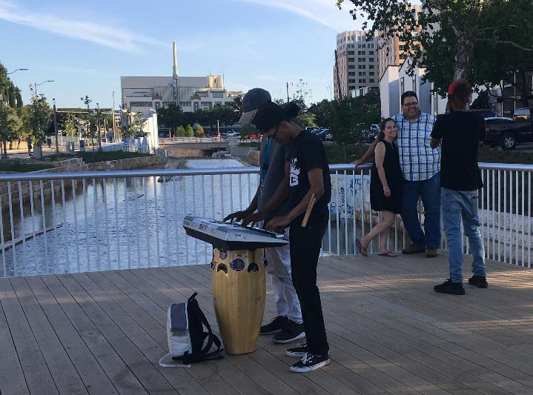
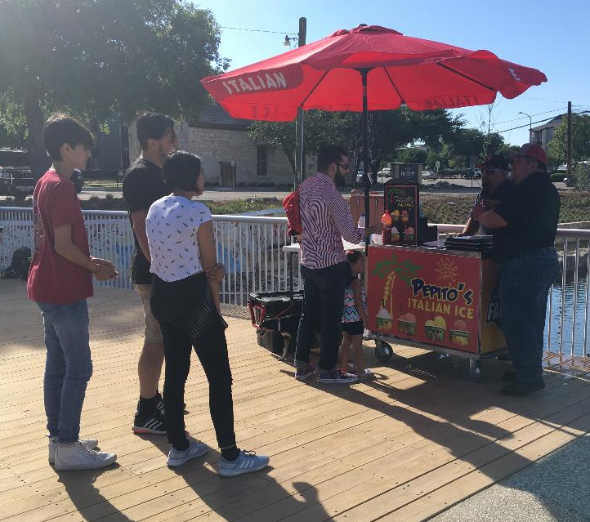
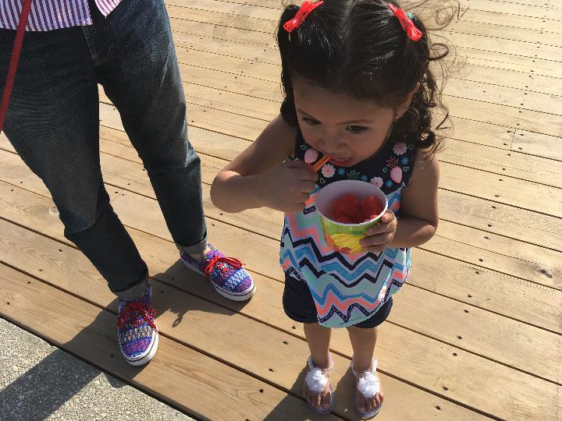
MAY 8
The Beat of Your Drum
Drum Café
Real Musiq Street Performers
Pepito’s
The Grate BBQ Co.

Slide 4
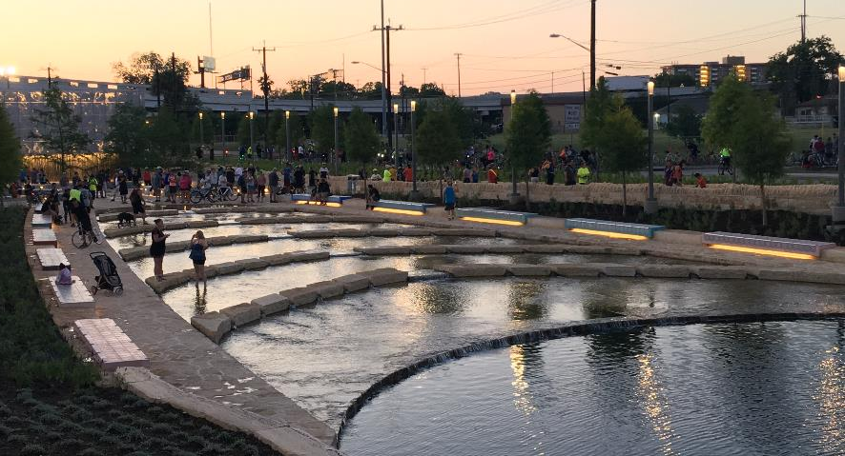
MAY 8
The Beat of Your Drum
Drum Café
Real Musiq Street Performers
Pepito’s
The Grate BBQ Co.

Slide 5
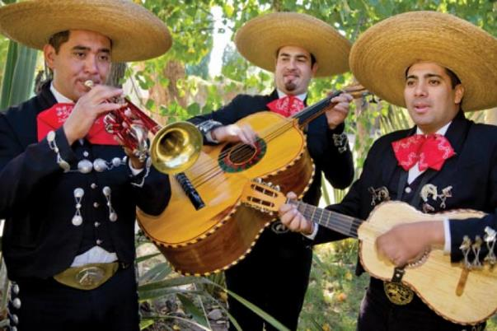
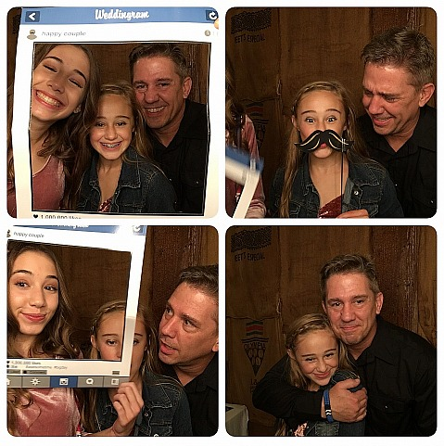
COMING UP…
Mums the Word
May 12

Slide 6
QUESTIONS?

