Slide 1
Est. May 5th 2018

Slide 3
Phase 1.2 Construction Update
Early Work Package 11: Demolition and Utility relocation
Additional Calder Alley Archeological Mitigation
Raba Kistner developing plan for additional investigations
Plan to be submitted to COSA OHP and THC for approval

Slide 4
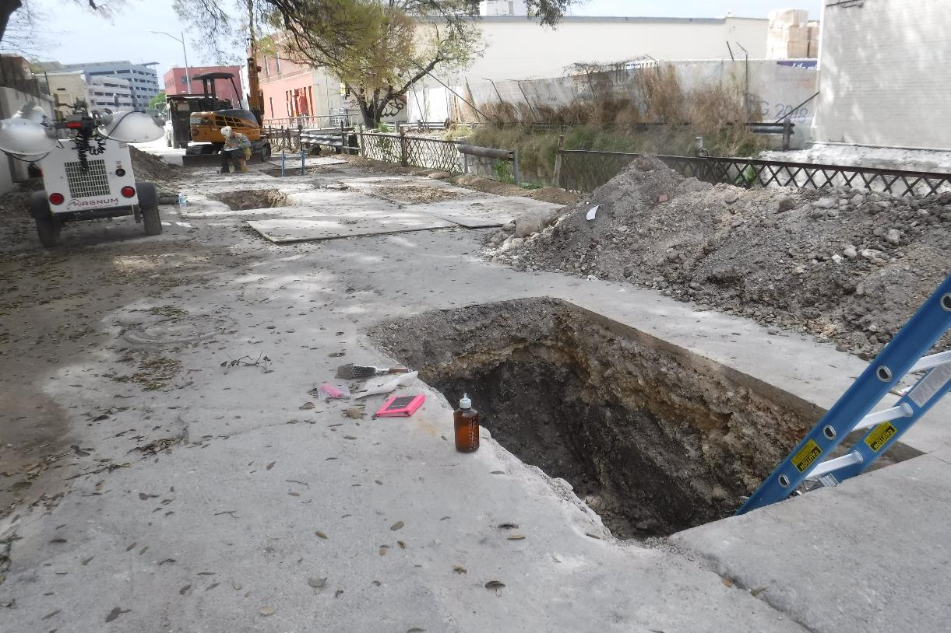

Slide 5
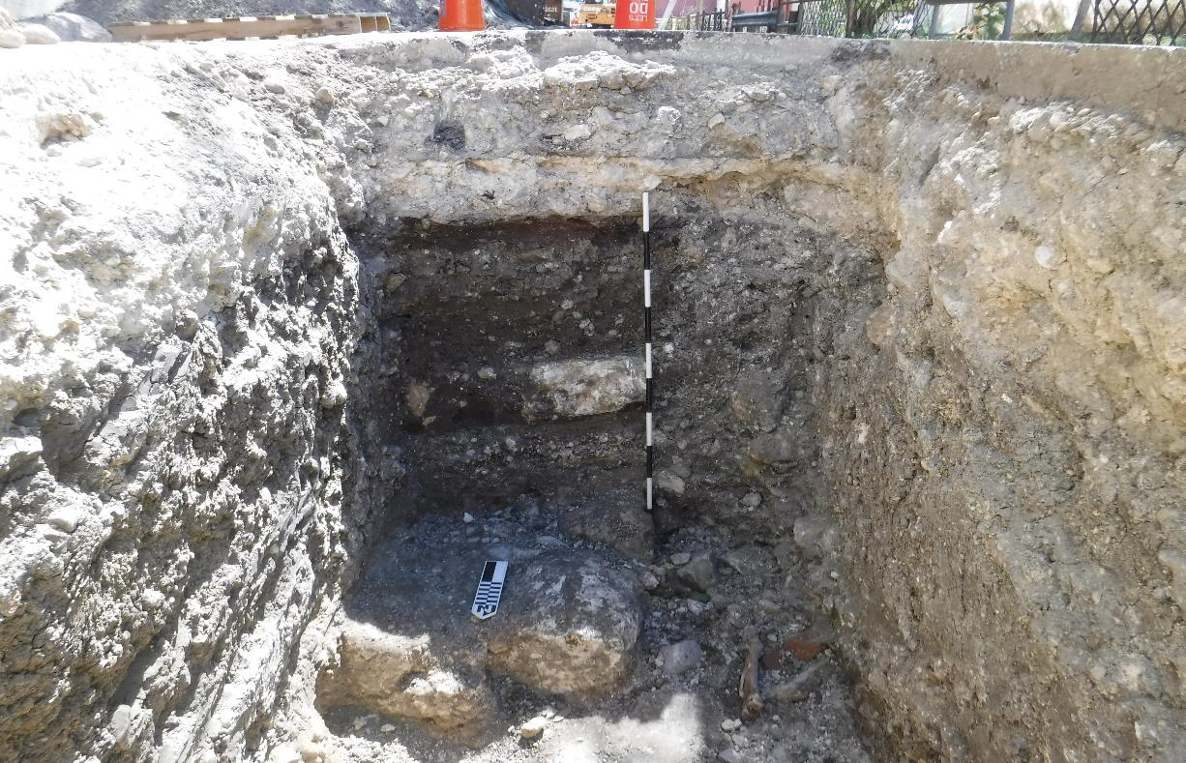

Slide 6
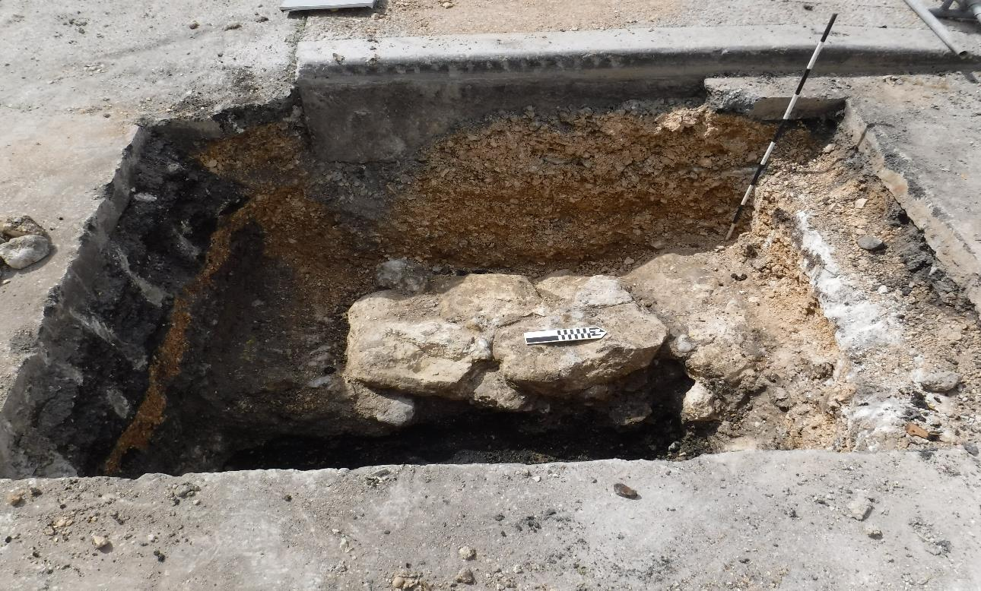

Slide 7
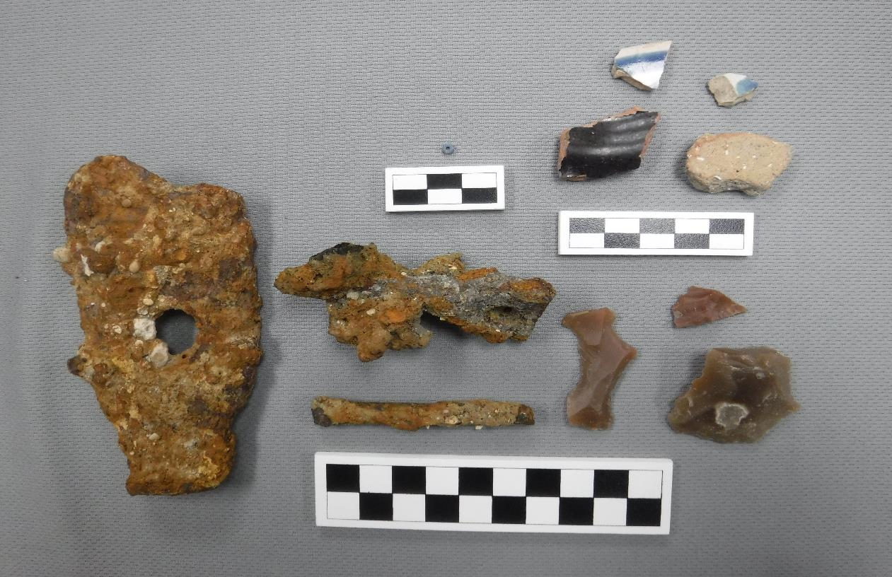

Slide 8
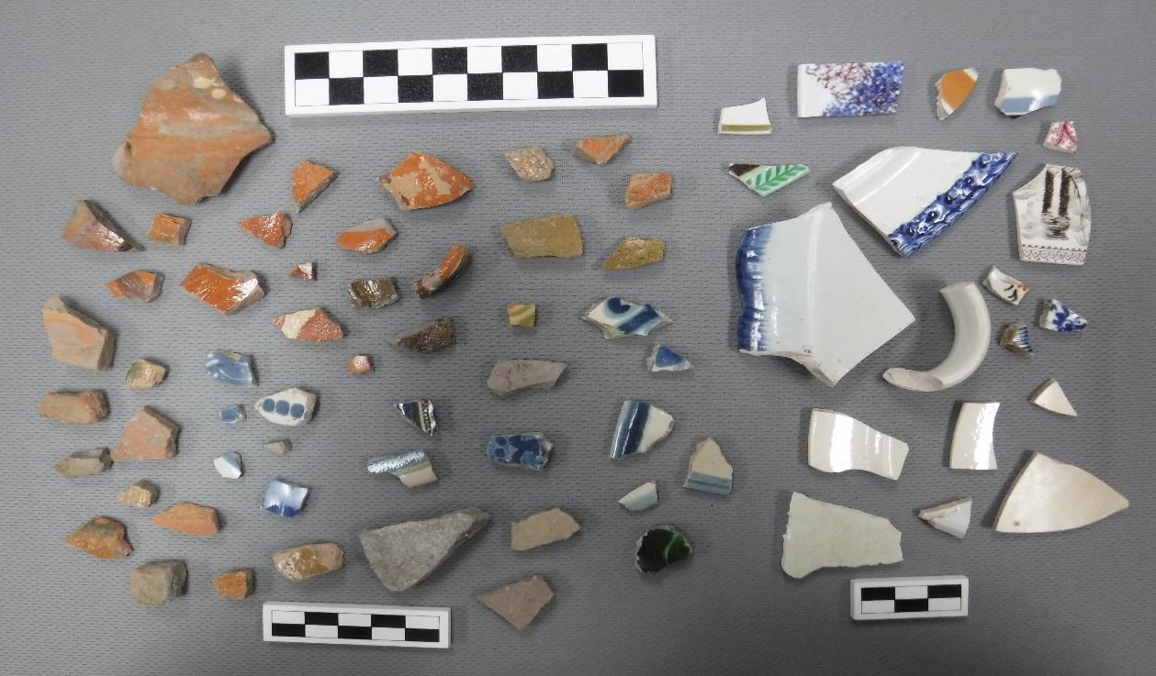

Slide 9
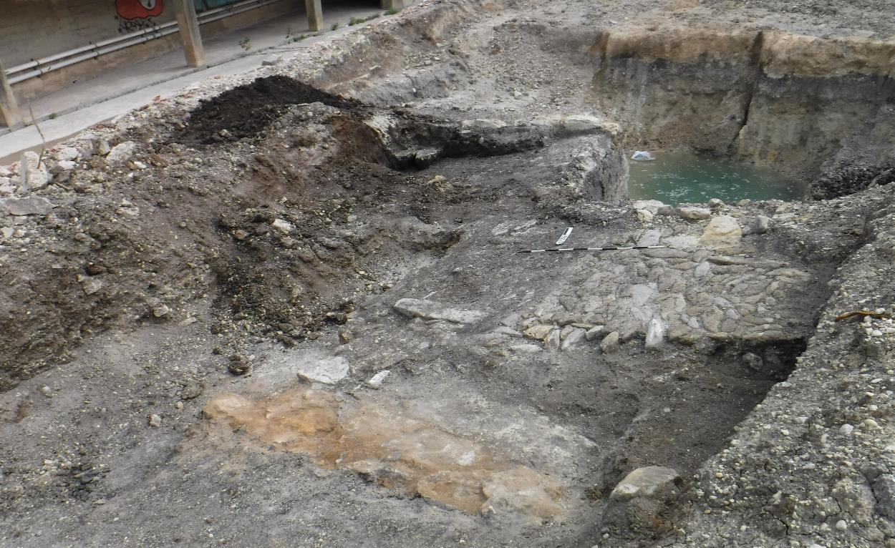

Slide 10
Phase 1.2 Construction Update
Early Work Package 12: Heavy Civil Construction
AH Beck mobilized to the site of the Dollar General to begin drilled piers on 4/30
Groundwater mitigation required
Initial testing did not find contaminants above the minimum levels
No treatment required before discharging into creek
Continual testing will be conducted

Slide 11
Phase 1.2 Construction Update
Commerce Street construction
Full closure to begin in June
3-month duration
One lane open beginning early September
13-month duration
Coordination with COSA project team ongoing
Street project to let in September

Slide 12
Phase 1.2 Design Update
Design team working on 100% completion
QA/QC submittal May 31
Final submittal June 15
Guaranteed Maximum Price submittal August 15
Coordination with SDJV ongoing

Slide 13
Partner Coordination
Executive Committee
David Smith, County Manager, Bexar County
Lori Houston, Assistant City Manager, City of San Antonio
Mike Frisbie, Director, Transportation and Capital Improvements, City of San Antonio
Suzanne Scott, General Manager, San Antonio River Authority
May 21: Regular Monthly Meeting
April 12: City Council approved O&M Agreement

Slide 14
QUESTIONS
& COMMENTS

