Slide 1
Established May 5, 2018

Slide 2
CONGRATULATIONS!
Notes:
Swipes – How many times our filter was seen in Snaps being created on grand opening day
Uses – Number of times our filter was sent to a friend or added to a Story
Views – Number of times our filter was seen in a Snap sent directly to a friend, or in a Story
Usage – How often our filter was chosen to use in a Snap

Slide 3
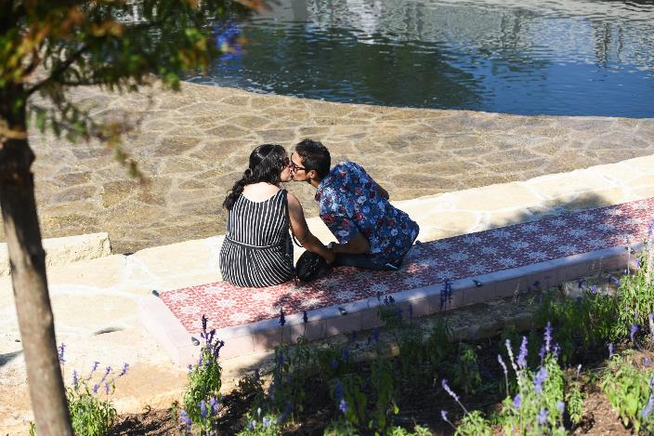
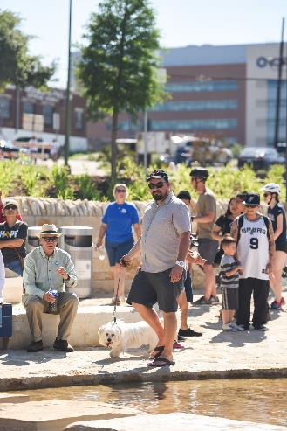
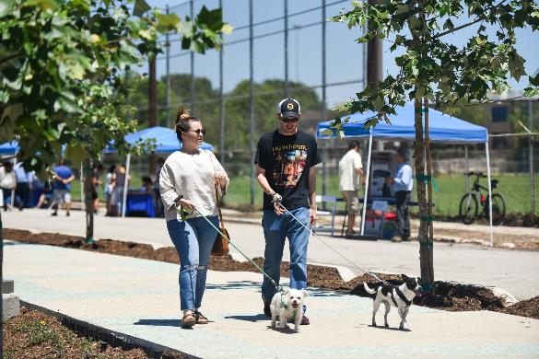
Grand Opening
Attendance:
estimated 4-5,000

Slide 4
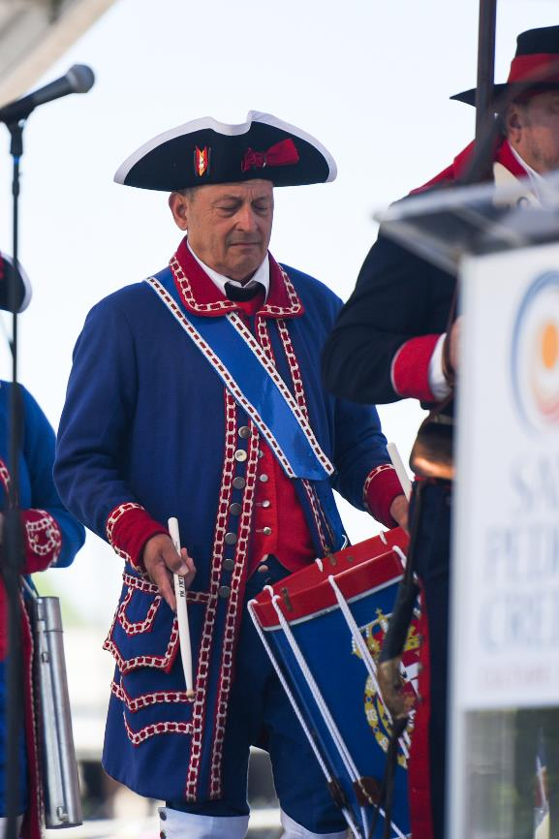
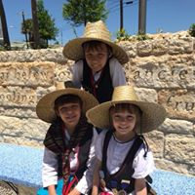
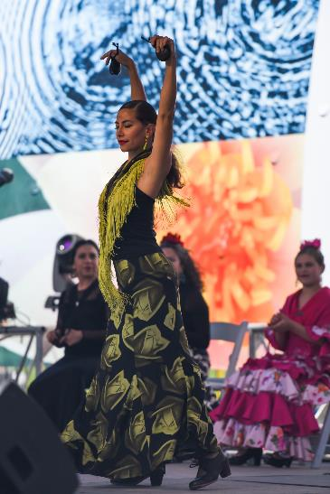
Grand Opening

Slide 5
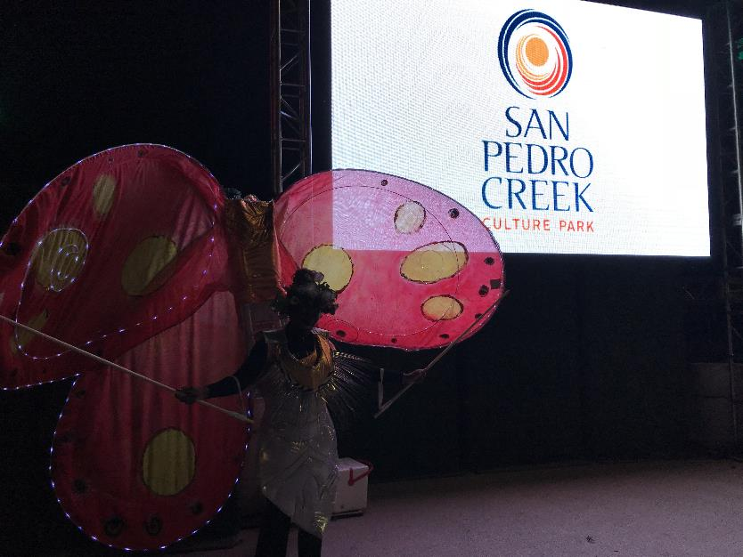
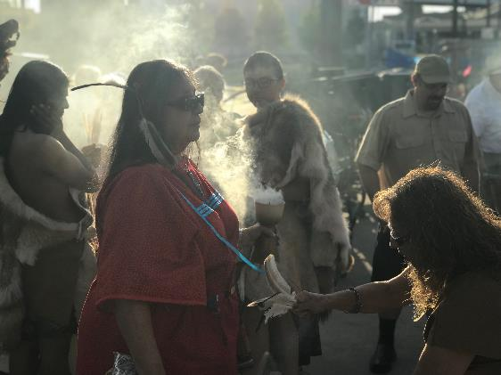
Grand Opening

Slide 6
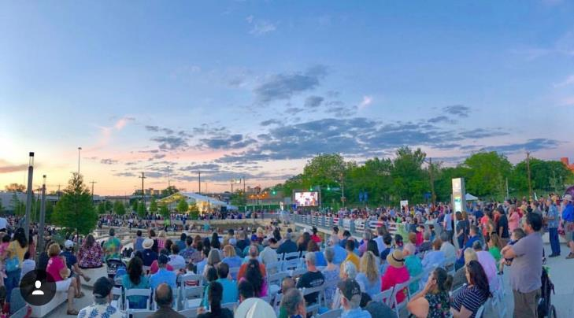
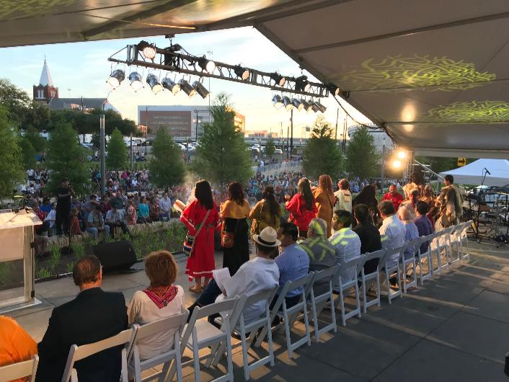
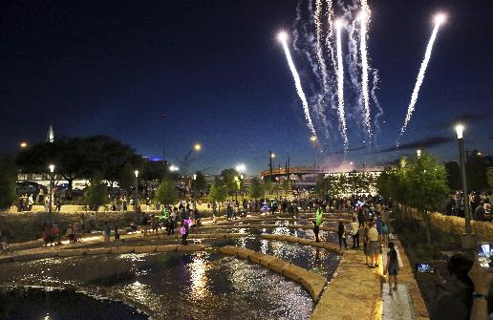
Grand Opening
Credit: Tom Reel - San Antonio Express-News

Slide 7
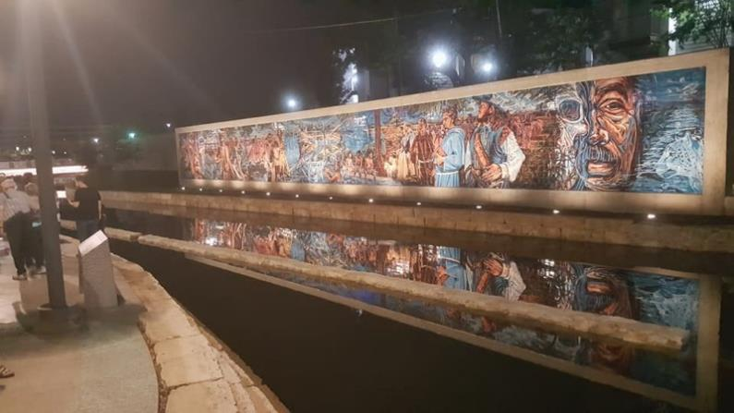
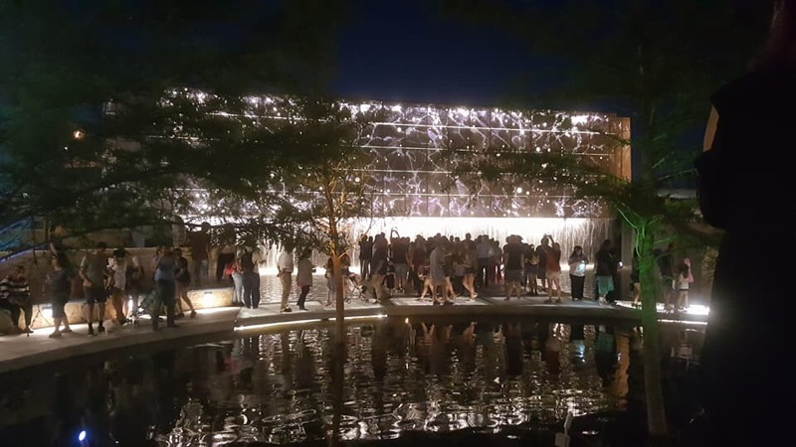
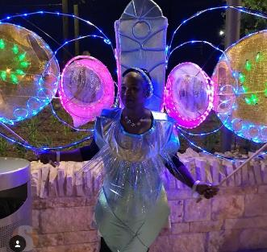
Grand Opening

Slide 8
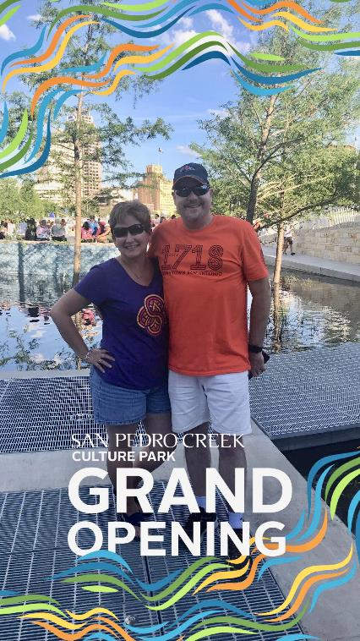
Social Media
Facebook - 5,113 total fans
(Increase by 18.03% since April 5)
Instagram - 1,686 total fans
(Increase by 22.35% since April 5)
Twitter - 935 total followers
(Increase by 12.24% since April 5)
Snapchat
Notes:
Swipes – How many times our filter was seen in Snaps being created on grand opening day
Uses – Number of times our filter was sent to a friend or added to a Story
Views – Number of times our filter was seen in a Snap sent directly to a friend, or in a Story
Usage – How often our filter was chosen to use in a Snap

Slide 9
Mobile App
iOS downloads
176 installations of iOS version
Google Play
149 installs of Android version
TOTAL: 325 downloads
Notes:
Swipes – How many times our filter was seen in Snaps being created on grand opening day
Uses – Number of times our filter was sent to a friend or added to a Story
Views – Number of times our filter was seen in a Snap sent directly to a friend, or in a Story
Usage – How often our filter was chosen to use in a Snap

Slide 10
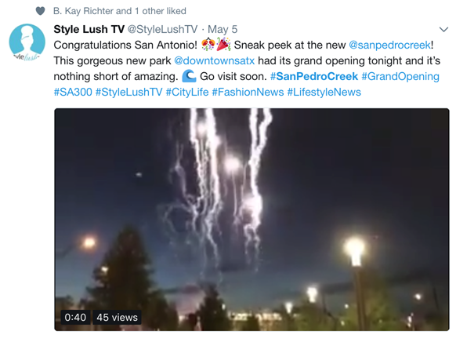
Public Feedback
Notes:
Swipes – How many times our filter was seen in Snaps being created on grand opening day
Uses – Number of times our filter was sent to a friend or added to a Story
Views – Number of times our filter was seen in a Snap sent directly to a friend, or in a Story
Usage – How often our filter was chosen to use in a Snap

Slide 11
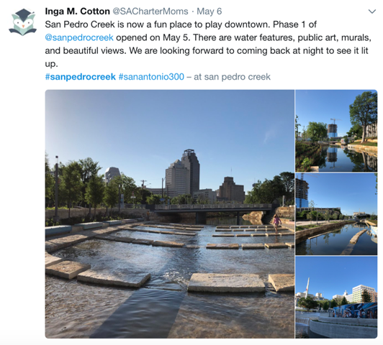
Public Feedback
Notes:
Swipes – How many times our filter was seen in Snaps being created on grand opening day
Uses – Number of times our filter was sent to a friend or added to a Story
Views – Number of times our filter was seen in a Snap sent directly to a friend, or in a Story
Usage – How often our filter was chosen to use in a Snap

Slide 12
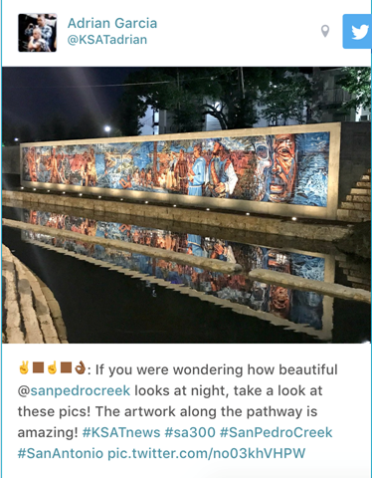
Public Feedback
Notes:
Swipes – How many times our filter was seen in Snaps being created on grand opening day
Uses – Number of times our filter was sent to a friend or added to a Story
Views – Number of times our filter was seen in a Snap sent directly to a friend, or in a Story
Usage – How often our filter was chosen to use in a Snap

Slide 13
QUESTIONS

